Slide 1


Sarvajanik Education Society Sarvajanik College of Engineering and Technology, Surat. Department of Computer Applications Academic Year: 2025– 26
A Project On
“AYH MART: Checkout System”
Presented By
Aum (ET25IMCA039)
Yash (ET25IMCA044)
HariKrushna (ET25IMCA008)
IMCA I Sem-2
Under the Guidance of
Prof. Veer Pachchigar

Slide 2
A Project On
AYH MART - Checkout System
Programme IMCA I Sem-2
Under the Guidance of Prof. Veer Pachchigar
Presented By
Aum - ET25IMCA039 Yesh - ET25IMCA044
HariKrushna - ET25IMCA008

Slide 3

What we'll cover Agenda
Project Abstract
Objective
System Description
Screenshots
Test Cases
References

Slide 4


Project abstract
AYH Mart checkout system
AYH Mart is a console-based checkout system developed in C, designed for a retail store. It allows customers to independently browse products, add items to a cart, and complete purchases via Cash or UPI QR Code.
The system supports three user roles - Customer, Staff, and Admin - each with a dedicated portal. Key features include product inventory management, a tiered membership discount program (Silver, Gold, Platinum), customer account management, and a detailed sales reporting module.
All data is managed in-memory using C structures, making the system
lightweight, efficient, and fully functional as a retail management
solution.

Slide 5
System description
Languages, libraries, data structures and functions
Language & Platform
C (Standard C)
Windows Console App
GCC / Dev-C++
Architecture
Menu-driven, modular function design.
5 core modules:
Inventory
Members
Customer Self-Checkout
Sales Reports
Customer Accounts
Libraries used
stdio.h — I/O operations
string.h — String handling
ctype.h — Char classification
stdlib.h — System calls, exit()
windows.h — UTF-8 / Unicode support

Slide 6
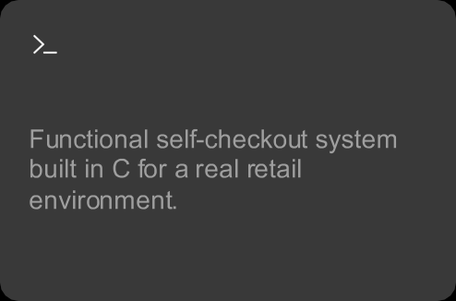



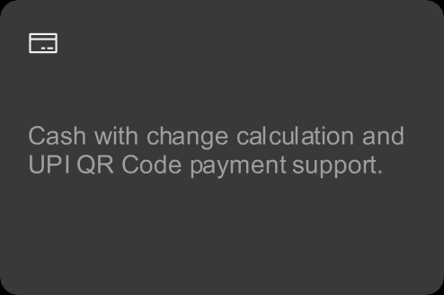

Project objectives
C-based system
Role-based access
Inventory management
Tiered membership
Dual payment
Sales reports

Slide 7
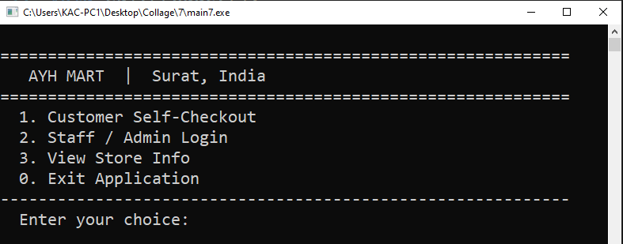
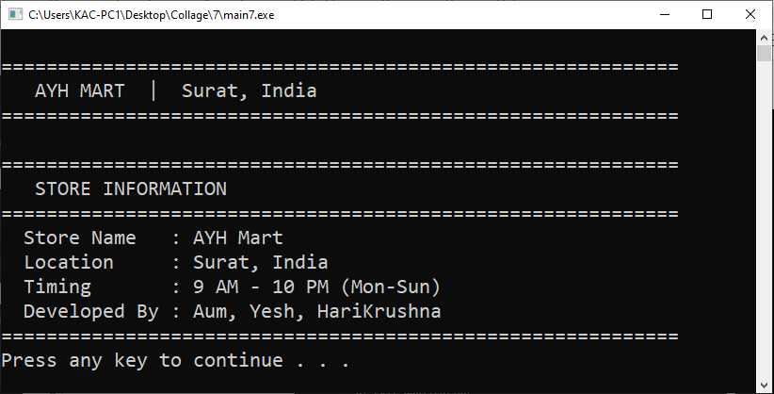
Screenshots
Main menu
View Store Info

Slide 8
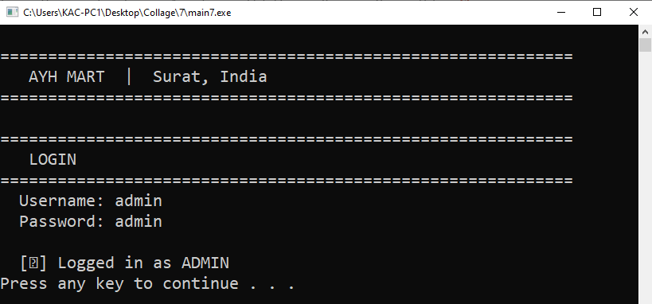
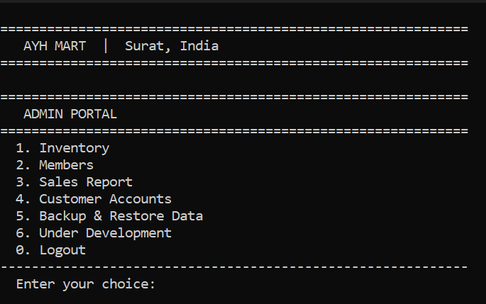
Screenshots
Screenshots
Admin Login
Admin Portal

Slide 9
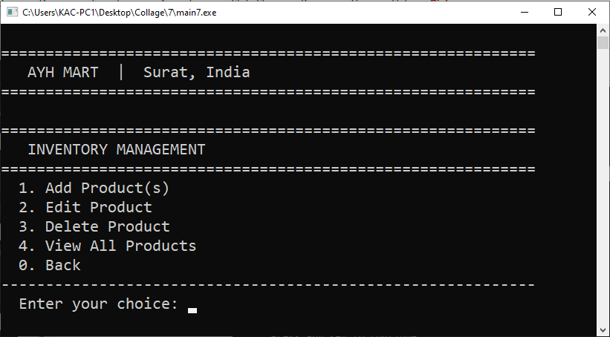
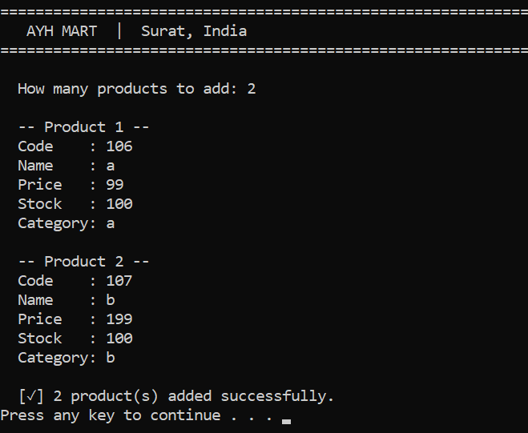
Screenshots
Inventory Management
Add Product(s)

Slide 10
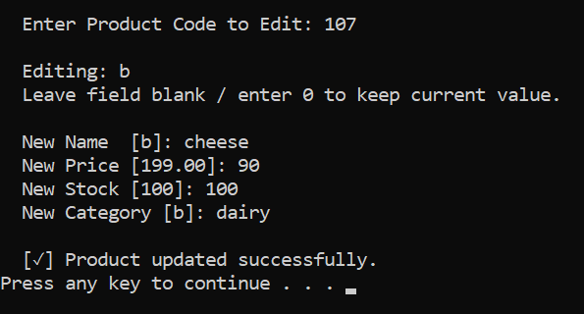
Screenshots
Inventory Management
Edit Product

Slide 11
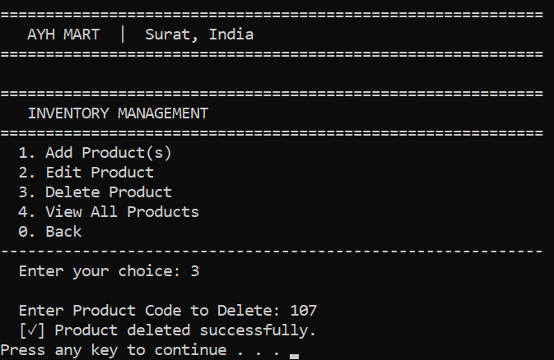
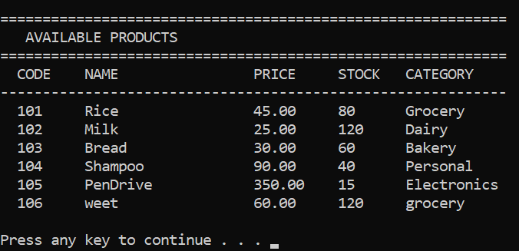
Screenshots
Delete Product
View all Product

Slide 12
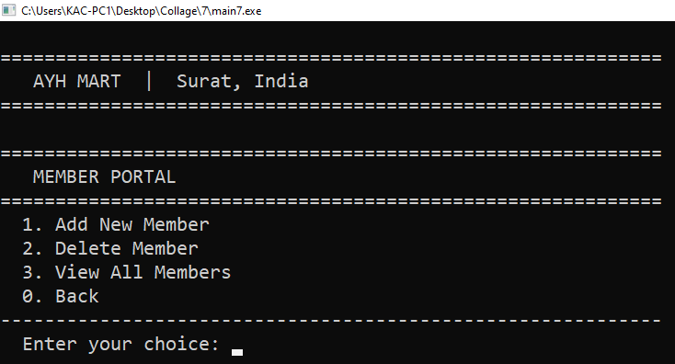
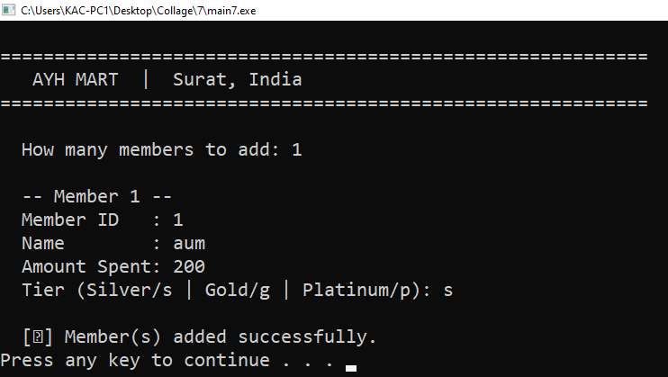
Screenshots
Member Portal
Add New Member

Slide 13
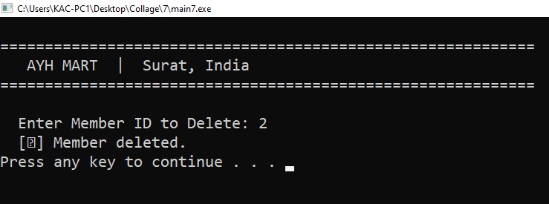
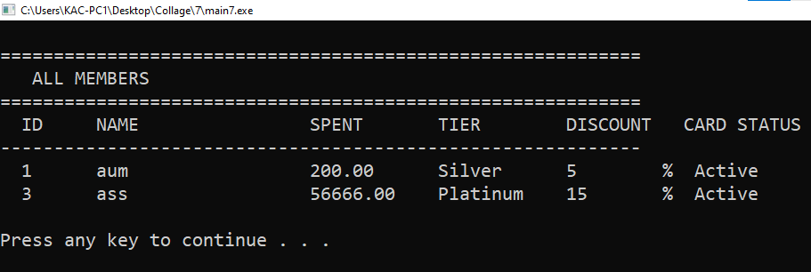
Screenshots
Delete Member
View all Member

Slide 14
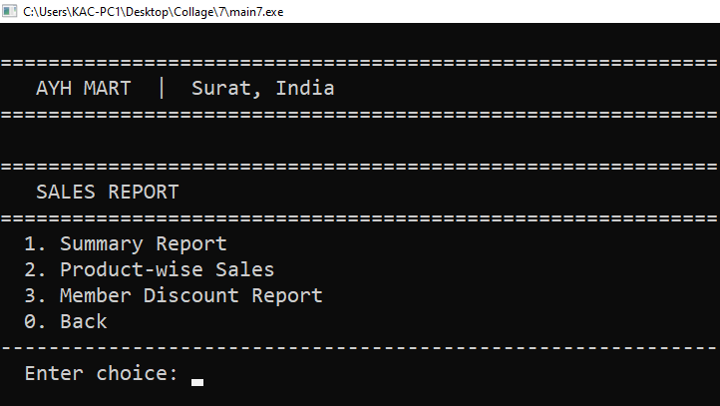
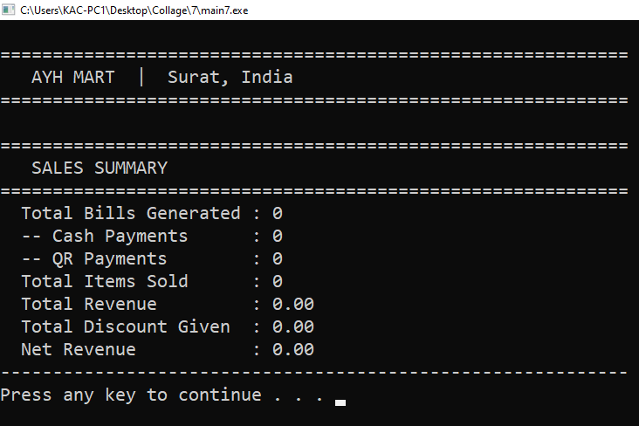
Screenshots
Sales Report
Sale Summary

Slide 15
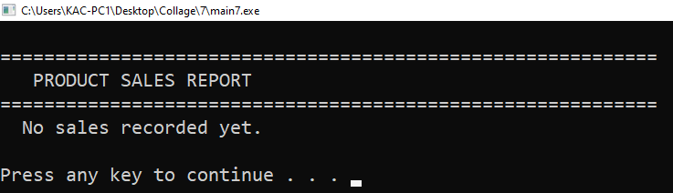
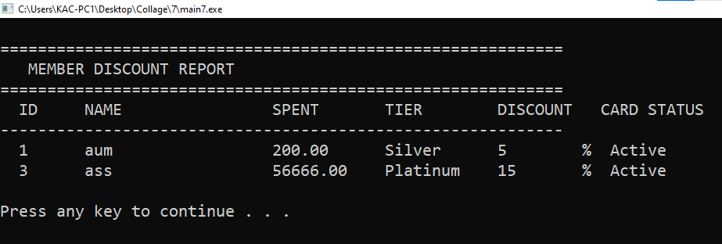
Screenshots
Product Sales Report
Member Discount Report

Slide 16
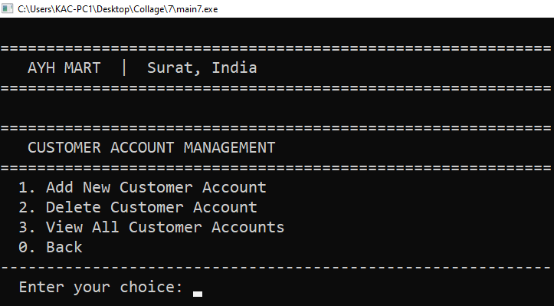
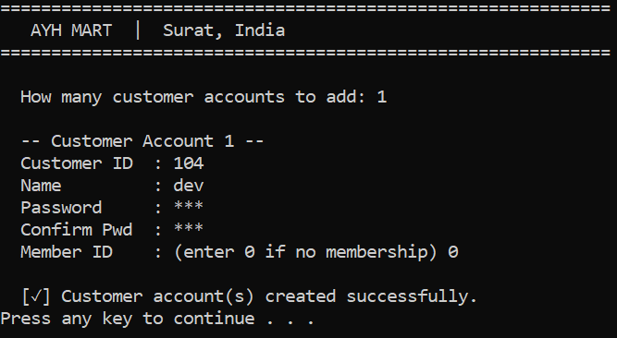
Screenshots
Customer Account Management
Add New Customer Account

Slide 17
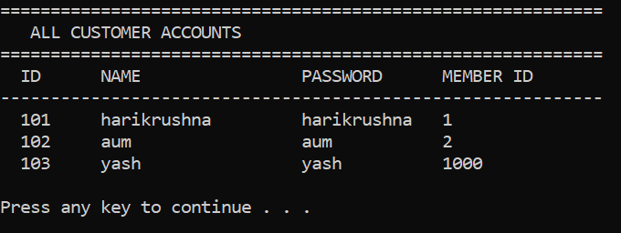
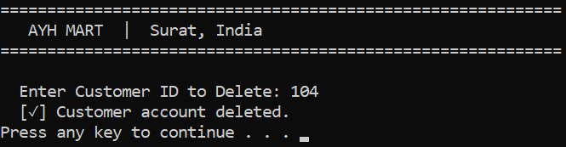
Screenshots
View all Customer
Delete Customer

Slide 18
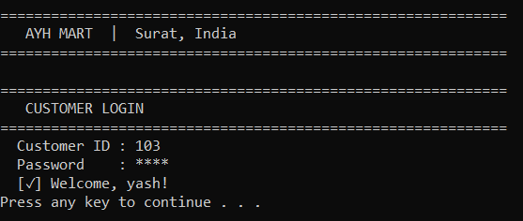
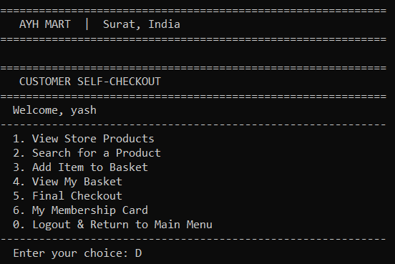
Screenshots
Customer Login
Customer Portal

Slide 19
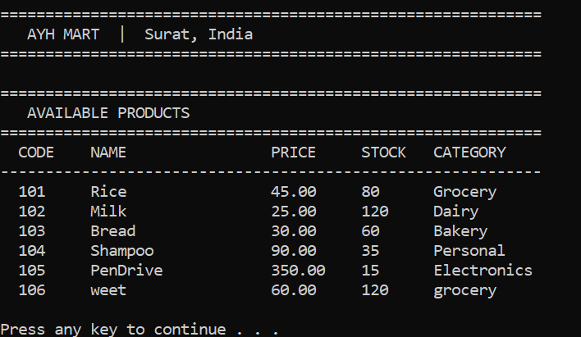
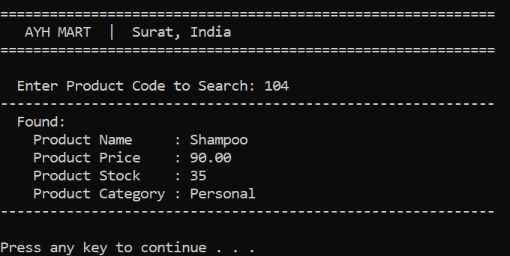
Screenshots
View Product
Search Product

Slide 20
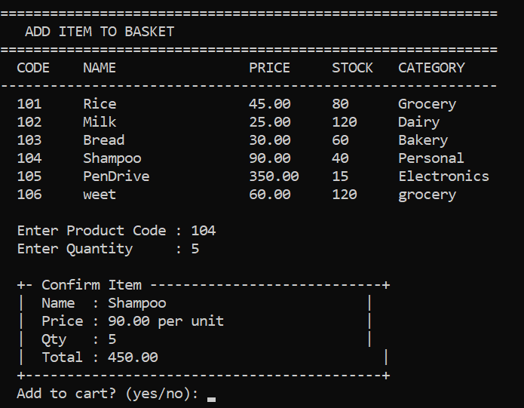
Screenshots
Add Item To Basket

Slide 21
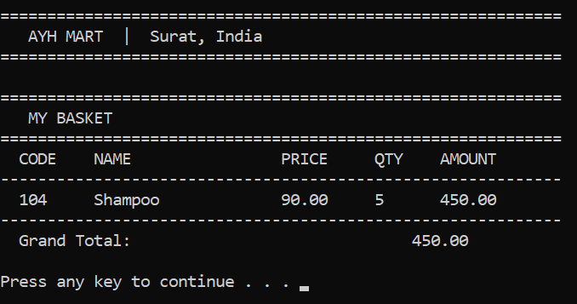
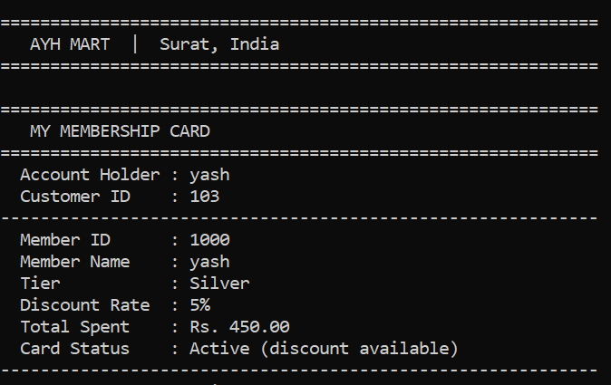
Screenshots
View Basket
View Membership Card

Slide 22
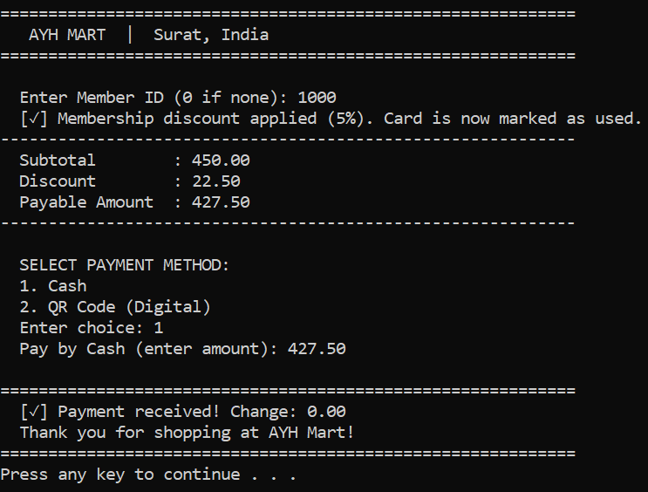
Screenshots
Check-Out via cash

Slide 23
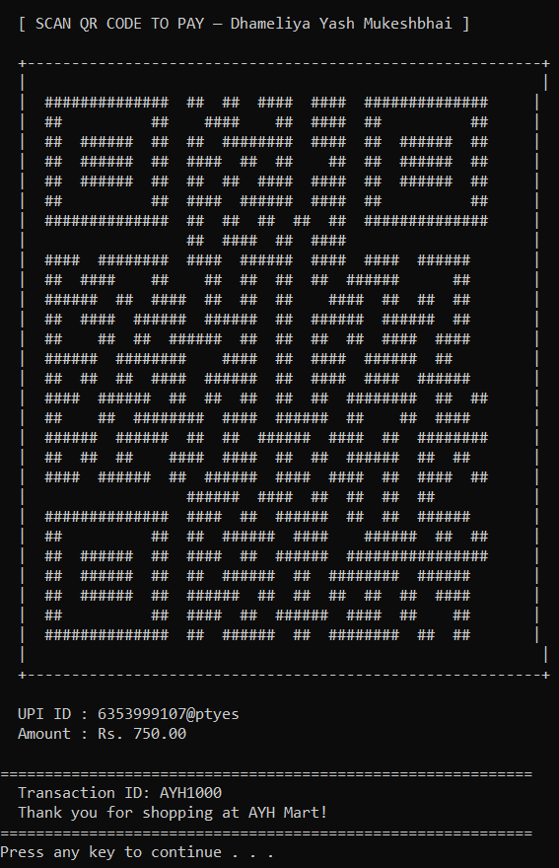
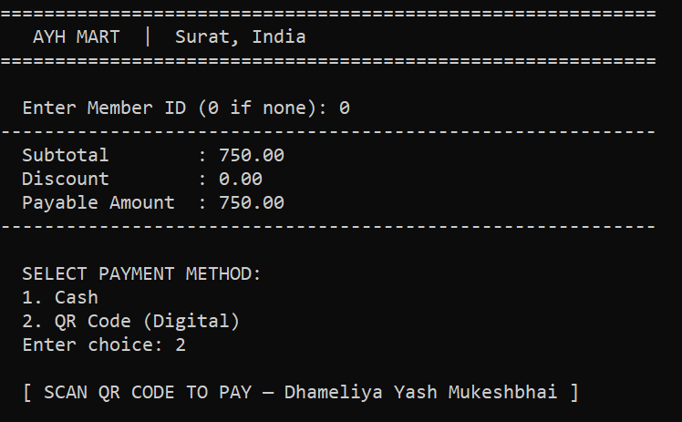
Screenshots
Check-Out via QR

Slide 24
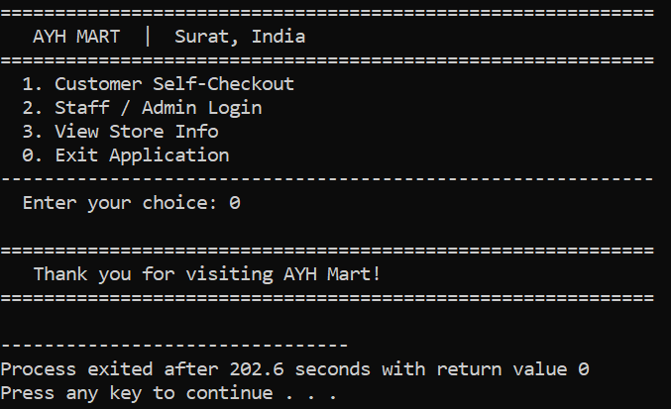
Screenshots
Exit Application

Slide 25

Test Cases
AYH MART

Slide 26
1. AUTHENTICATION TEST CASES
TC ID | Scenario | Input | Expected Output | Result
TC01 | Admin login valid | admin / admin | Admin dashboard opens | Pass
TC02 | Staff login valid | staff / staff | Staff portal opens | Pass
TC03 | Login invalid | Wrong credentials | Error message shown | Pass
TC04 | Empty login | Blank input | Error / retry | Pass
TC05 | Case sensitivity | Admin/Admin | Login fail | Pass
TC06 | Password masking | Enter password | Hidden input (*) | Pass

Slide 27
2. CUSTOMER LOGIN
TC ID | Scenario | Input | Expected Output | Result
TC07 | Valid customer login | Correct ID + pass | Welcome message | Pass
TC08 | Invalid login | Wrong ID/pass | Error message | Pass
TC09 | No customers exist | Login attempt | Fail safely | Pass

Slide 28
3. INVENTORY MANAGEMENT
TC ID | Scenario | Input | Expected Output | Result
TC11 | Add product | Valid data | Product added | Pass
TC12 | Add product overflow | >100 items | Limit warning | Pass
TC13 | Edit product | Valid code | Updated product | Pass
TC14 | Edit invalid product | Wrong code | Not found | Pass
TC15 | Delete product | Valid code | Product removed | Pass
TC16 | View products | — | Product list shown | Pass
TC17 | Duplicate product code | Same code | Error message | Pass
TC18 | Delete invalid product | Wrong code | Error message | Pass

Slide 29
4. MEMBER MANAGEMENT
TC ID | Scenario | Input | Expected Output | Result
TC19 | Add member | Valid input | Member created | Pass
TC20 | Invalid tier | Wrong input | Retry prompt | Pass
TC21 | Duplicate membership | Same customer | Error shown | Pass
TC22 | Delete member | Valid ID | Member removed | Pass
TC23 | Delete invalid member | Wrong ID | Error message | Pass
TC24 | View members | — | Member list shown | Pass

Slide 30
5. CUSTOMER ACCOUNT MANAGEMENT
TC ID | Scenario | Input | Expected Output | Result
TC25 | Add customer | Valid data | Account created | Pass
TC26 | Duplicate customer ID | Same ID | Error message | Pass
TC27 | Password mismatch | Wrong confirm | Retry | Pass
TC28 | Delete customer | Valid ID | Account removed | Pass
TC29 | Delete invalid customer | Wrong ID | Error message | Pass
TC30 | View customers | — | List shown | Pass

Slide 31
6. PRODUCT SEARCH & VIEW
TC ID | Scenario | Input | Expected Output | Result
TC31 | Search valid product | Existing code | Product details | Pass
TC32 | Search invalid product | Wrong code | Not found message | Pass
TC33 | View all products | — | Display list | Pass

Slide 32
7. CART OPERATIONS
TC ID | Scenario | Input | Expected Output | Result
TC34 | Add to cart valid | Code + qty | Item added | Pass
TC35 | Insufficient stock | qty > stock | Error shown | Pass
TC36 | Invalid product | Wrong code | Not available | Pass
TC37 | Cart overflow | >50 items | Cart full message | Pass
TC38 | Add item cancel | "no" | Not added | Pass
TC39 | View empty cart | — | Basket empty | Pass

Slide 33
8. CHECKOUT & PAYMENT
TC ID | Scenario | Input | Expected Output | Result
TC40 | Checkout empty cart | — | Warning message | Pass
TC41 | Checkout with items | Valid | Bill generated | Pass
TC42 | Cash exact payment | Exact amount | Success | Pass
TC43 | Cash extra payment | > amount | Change returned | Pass
TC44 | Cash insufficient | < amount | Retry payment | Pass
TC45 | QR payment | Select QR | QR displayed + success | Pass

Slide 34
9. MEMBERSHIP DISCOUNT
TC ID | Scenario | Input | Expected Output | Result
TC46 | Valid member discount | Active ID | Discount applied | Pass
TC47 | Used membership | Same ID again | No discount | Pass
TC48 | Invalid member ID | Wrong ID | No discount | Pass
TC49 | No membership | ID = 0 | No discount | Pass

Slide 35
10. SALES REPORT
TC ID | Scenario | Input | Expected Output | Result
TC50 | Sales summary | — | Stats shown | Pass
TC51 | Product sales | — | Sales list | Pass
TC52 | Discount report | — | Member report | Pass
TC53 | No sales yet | — | Empty message | Pass

Slide 36
11. FILE HANDLING / BACKUP
TC ID | Scenario | Input | Expected Output | Result
TC54 | Save data | Backup option | Files saved | Pass
TC55 | Load data | Restore option | Data loaded | Pass
TC56 | Restore cancel | Select NO | Operation cancelled | Pass
TC57 | Missing files | No file present | Default data loaded | Pass

Slide 37
12. EDGE / STRESS CASES
TC ID | Scenario | Input | Expected Output | Result
TC58 | Negative quantity | -5 | Reject input | Pass
TC59 | Large input strings | Long name | No crash | Pass
TC60 | Rapid operations | Fast inputs | Stable system | Pass
TC61 | Max limits reached | Full data | Warning shown | Pass

Slide 38




References
https://www.gofrugal.com/retail/?ref=common-header
https://www.zoho.com/in/inventory/features/
Offline store

Slide 39
Thank You
AYH MART - Self Checkout System Presentation
AYH MART

